Slide 1
Credit Card Financial dashboard

Slide 2
Problem Statement
The primary goal is to analyze and optimize the performance of credit card transactions. This involves:
Identifying the most profitable customer segments and card categories.
Understanding spending behaviors and preferences.
Monitoring trends in transaction types and expenditures.
Ensuring high customer satisfaction and addressing areas of improvement.

Slide 3
Project objective
To develop a comprehensive credit card transaction dashboard that provides real-time insights into key performance metrics and trends, enabling stakeholders to monitor and analyze credit card operations effectively.

Slide 4
insights
Key Performance Metrics
Total Number of Clients: 10.1K
Total Transaction Amount: $45 million
Total Revenue: $11 million
Total Customer Acq Cost: $973K
Satisfaction Rate: 3.19
Total Transaction Count: 656K
Revenue by Transaction Type
Swipe: $7 million
Chip: $ million
Online: $1 million
Most transactions are conducted through swiping, indicating a preference for physical card use over chip and online transactions.

Slide 5
insights
Revenue by Card Category
Blue: $9 million
Silver: $1 million
Gold: $0.435 million
Platinum: $0.1823 million
The majority of the revenue comes from the Blue Card category, which is $9M Other card categories like Silver, Gold, and Platinum have smaller contributions. This suggests that the Blue Card is the most popular or broadest customer base.
Revenue by Customer Job
Businessman: $3million
White-collar: $2million
Self-employed: $2million
Government: $2million
Blue-collar: $1million
Retirees: $1 million
Businessmen, white-collar, Self-employed and Government professionals contribute the most to revenue, indicating that higher-income professions have a higher credit card usage rate.

Slide 6
Insights
Revenue by Education Level
Graduates are the highest contributors with $4.4M.
High school graduates generate $2.2M.
Those with unknown education levels contribute $1.7M.
Uneducated individuals generate $1.6M.
Post-graduates generate $0.6M.
Doctorate holders generate $0.5M.
Graduates and high school graduates are the primary contributors to revenue. The revenue from post-graduates and doctorates is relatively low.
Revenue by Expense Type
Bills are the largest expense category $2.8M.
Entertainment Expenses generate $1.9M.
Fuel Expenses generate $1.8M.
Grocery expenses are $1.7M.
Food expenses are $1.5M.
Travel expenses are $1m.
Bills, entertainment and Fuel are the leading expense types, generating $2.8M, $1.9M and $1.8M respectively. These categories could be targeted for offers.

Slide 7
insights
Revenue by Age Group:
Customers aged 40-50 generate the highest revenue which is $4.8M.
The 50-60 age group follows with $3.5M.
The 30-40 age group contributes $1.9M.
The younger (18-30) and older (60+) age groups generate significantly less revenue at $0.2M and $0.5M, respectively, suggesting that middle-aged customers are the primary revenue drivers.
Customer Satisfaction:
The satisfaction rate of 3.19 suggests that there might be room for improvement in customer satisfaction. This could be further investigated to understand the underlying causes and address them.
Activation within 30 Days:
The Overall Activation Rate is 57.47%
Delinquent Accounts:
The Overall Delinquent Rate is 6.07%

Slide 8
Conclusion
Enhance the security and convenience of chip transactions.
Tailor marketing strategies to further boost the popularity of Blue category cards.
Develop targeted campaigns for the 40-50 age group and businessmen, who show high engagement and spending.
Leverage the financial habits of graduates by offering specialised financial products and services.
Promote credit card use for bill payments to ensure consistent revenue inflow.

Slide 9
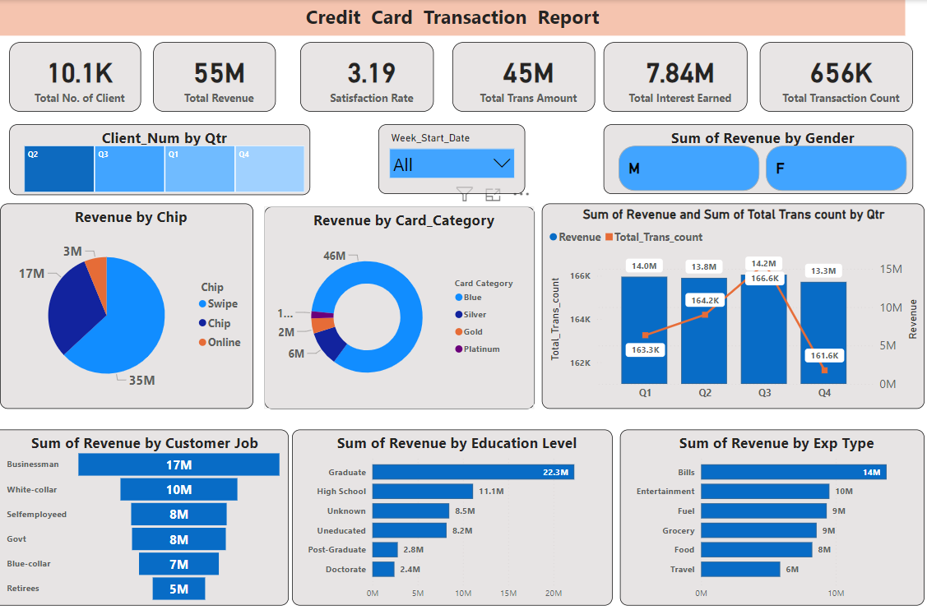
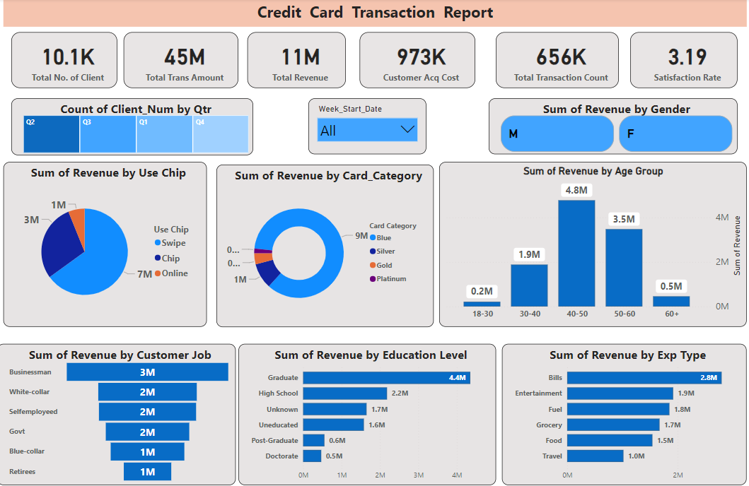
dashboard

Slide 10
THANK YOU

